Slide 1




My Algebra Interactive Notebook
$$3ab$$
$$2x+3y$$
$$\frac{5xy}{6}$$
Name :
Class :
Term 2 Semester 1
$$y=2x+1$$

Slide 2
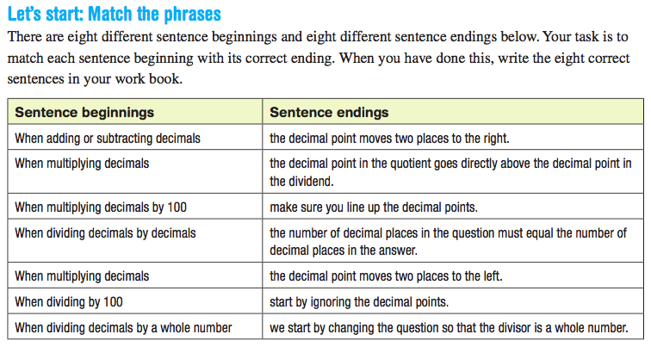
Task: Find a partner and match the correct sentence beginnings and endings. Write in the LHS of both your INBs.

Slide 3
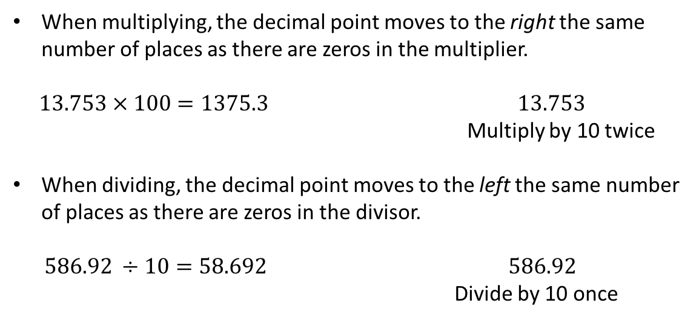
24
7
30
Date
Operations with Decimals
EQ – What are the key steps to multiplying and dividing decimals?
Multiplying and dividing
decimals by powers of 10
When multiplying, the decimal point moves to the right the same number of places as there are zeros in the multiplier.
$13.753 × 100=1375.3$ $13.753$
Multiply by 10 twice
When dividing, the decimal point moves to the left the same number of places as there are zeros in the divisor.
$586.92 ÷10=58.692$ $586.92$
Divide by 10 once

Slide 4
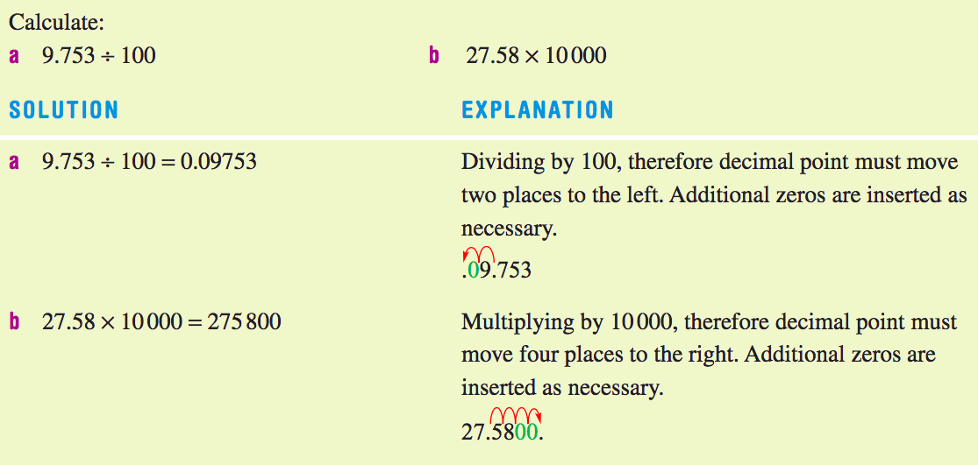
24
7
30
Date
Operations with Decimals
EQ – What are the key steps to multiplying and dividing decimals?
Multiplying and dividing
decimals by powers of 10
Examples:

Slide 5
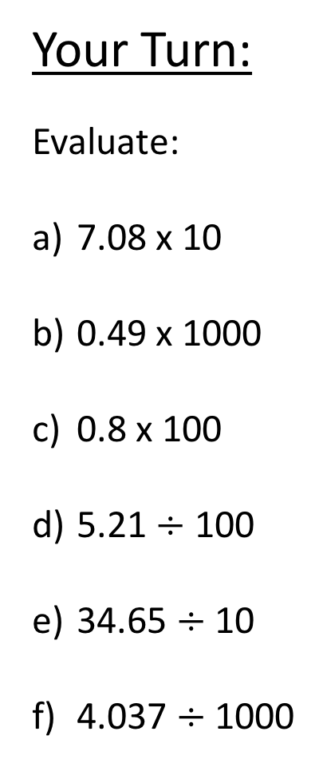
Your Turn:
Evaluate:
7.08 x 10
0.49 x 1000
0.8 x 100
5.21 $÷$ 100
34.65 $÷$ 10
4.037 $÷$ 1000

Slide 6
24
7
30
Date
Operations with Decimals
EQ – What are the key steps to multiplying and dividing decimals?
https://www.youtube.com/watch?v=BIV-kmDXo2s
Notes:
stop the video at the 1:45 mark before dividing decimals starts up

Slide 7
24
7
30
Date
Operations with Decimals
EQ – What are the key steps to multiplying and dividing decimals?
Multiplying
decimals
Don’t worry about the decimal until you’re done multiplying everything
First multiply, and then count up the places to the right of the decimal point and put the decimal in the answer.
3.51 x 1.4 ➔ 351
×14
1404
+3510
4914
first, multiply 351 by 4
then, multiply 351 by 10
then, add up the numbers
last, since there are a total of 3 decimal places in the problem, start from the right and move the decimal 3 places to the left in the answer (the problem has 3 decimal places and so does the answer)
3 decimal
places
➔ 4.914
So, 3.51 x 1.4 = 4.914!

Slide 8
24
7
30
Date
Operations with Decimals
EQ – What are the key steps to multiplying and dividing decimals?
Remember to only count numbers to the RIGHT of the decimal point.
2.3 × 0.0002 ➔ 23
× 2
46
➔ 0.00046
5 decimal
places
Sometimes you may see
.00046 instead of 0.00046. Both are right, but it’s more common to put a 0 in the ones place.
5 decimal
places
So, 2.3 x 0.0002 = 0.00046!

Slide 9
Try it yourself
1) 27.2 × 9.2 =
2) 3.2904 × 0.22 =
3) 62.5 × 12.8 =
4) 0.034 × 0.026 =
5) 8.02 × 2.1 =

Slide 10
24
7
30
Date
Operations with Decimals
EQ – What are the key steps to multiplying and dividing decimals?
Dividing Decimals
Problem: A wall measures 8.91 meters tall. You need to install 3.3 meter tall siding panels. How many panels do you need?
2.7
3.3|8.91
How did we figure this out without a calculator?!?!?
When dividing numbers with decimal points, decimal point placement is key.
Think of the division sign, | , like a house. With all division problems, the first number goes inside the house (the 8.91) and the second goes outside the house (3.3).
If you forget, think about a problem you know. 10 ÷ 2 = 5. You wouldn’t say 10 | 2. To work it out you’d say 2 |10 (2 goes into 10.)

Slide 11
24
7
30
Date
Operations with Decimals
EQ – What are the key steps to multiplying and dividing decimals?
Dividing Decimals
Step 1 - Move the decimal of the divisor (outside the house) as far to the right as you can
Step 2 - Move the decimal of the dividend (inside the house) by the same number of spaces
Step 3 - Move the decimal straight up onto the answer line
Step 4 - Divide like normal
Problem
8.91 ÷ 3.3
Steps 1 & 2
➔ 3.3 |8.91 ➔ 33 |89.1
Step 3
.
33 |89.1
Step 4
2.7
33 |89.1
- 66
231
- 231
0

Slide 12
24
7
30
Date
Operations with Decimals
EQ – What are the key steps to multiplying and dividing decimals?
Ex 1
Problem
8.91 ÷ 0.33
Steps 1 & 2
➔ 0.33 |8.91 ➔ 33 |891.
Step 3
.
33 |891.
Step 4
27.
33 |891.
- 66
231
- 231
0
Move the decimal 2 places to the right
Ex 2
Problem
5.76 ÷ 1.6
Steps 1 & 2
➔ 1.6 |5.76 ➔ 16 |57.6
Step 3
.
16 |57.6
Step 4
3.6
16 |57.6
- 48
96
- 96
0
Move the decimal 1 place to the right

Slide 13
Try it yourself
1) 60.8 ÷ 19 =
2) 187.53 ÷ 3 =
3) 3.2 ÷ 6.4 =
4) 187.53 ÷ 0.03 =

Slide 14
Homework – Real Life Examples
https://www.tes.com/teaching-resource/real-life-calculations-with-decimals-6315267

Slide 15
Notes Review
24, 7 ,30
Date
Title
Essential question
Notes complete
Notes complete with colour and diagrams
Questions completed
Contents page filled in
Formula page filled in

Slide 16
Homework
Review your notes and write a summary answering the essential question.

